Slide 1
CT Lung Anatomy: A Foundation for Diagnosis
Dr Ahmed Elsawaf MD

Slide 2
Introduction: Why Mastering Anatomy is Your First Tool
You cannot recognize the abnormal until you intimately know the normal.
Anatomy provides the roadmap for describing disease location (e.g., "right lower lobe nodule" vs. "a spot in the lung").
It informs your differential diagnosis (e.g., a mass in the anterior mediastinum has a different differential than one in the lung apex).
Today, we will build a systematic approach to navigating a CT chest, from the great vessels down to the secondary pulmonary lobule.

Slide 3
The Systematic Search Pattern: Your Diagnostic Checklist
A structured approach:
  Trachea & Central Airways
  Mediastinum & Great Vessels
  Hila (Pulmonary Vessels & Lymph Nodes)
  Lungs (Lobes, Fissures, Parenchyma)
  Pleura & Chest Wall
  Upper Abdomen (Liver, Spleen, Adrenals - "Don't miss!")
Always use the same pattern. This is how you avoid missing a small nodule because you were distracted by a large hiatal hernia."

Slide 4
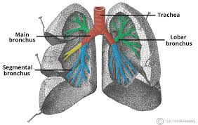
The Airways: From Trachea to Segmental Bronchi

Slide 5
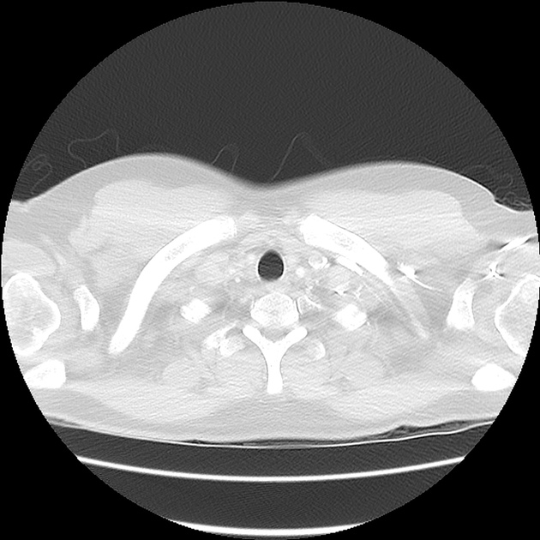
Trachea:

Slide 6
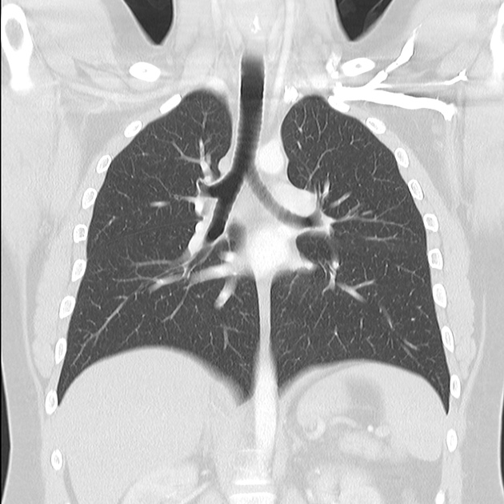
Carina and main bronchi:

Slide 7
Key Structures:
  Trachea: C-shaped cartilaginous rings.
  Carina: The ridge separating the right and left mainstem bronchi.
  Mainstem Bronchi: The right is wider, shorter, and more vertical than the left (why foreign bodies go right!).
  Lobar and Segmental Bronchi: Learn the names of the major segments (e.g., RUL apical, LLL superior).

Slide 8
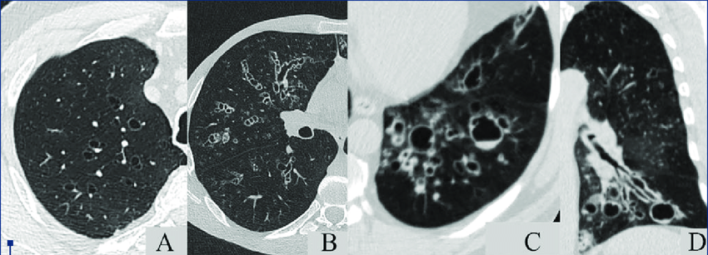
Clinical Pearl: "In the axial plane, an airway and its accompanying pulmonary artery should be the same size. If the airway is dilated and the artery looks small, think bronchiectasis."

Slide 9
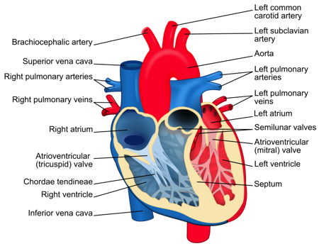
The Vasculature: Arteries vs. Veins

Slide 10
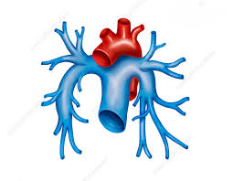
Pulmonary arteries (in blue):

Slide 11
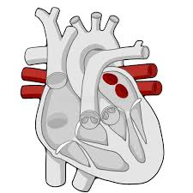
Pulmonary veins (in red)

Slide 12
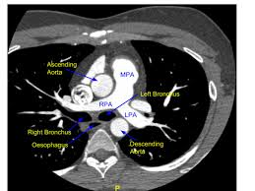
Pulmonary trunk divides into two arteries:

Slide 13
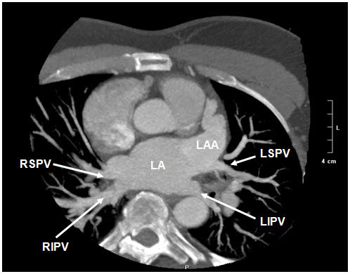
Four pulmonary veins (2 right and 2 left):

Slide 14
Pulmonary Arteries:
  Carry deoxygenated blood.
  Pulmonary trunk…..right and left main pulmonary arteries…..lobar branches ….segmental and subsegmental branches
  Follow the bronchi. They branch together.

Slide 15
Pulmonary Veins:
  Carry oxygenated blood.
  Four pulmonary veins: right superior, right inferior, left superior and left inferior veins
  Run between segments towards the left atrium.

Slide 16
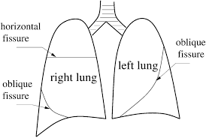
Lobes and Fissures: The Lung's compartments

Slide 17
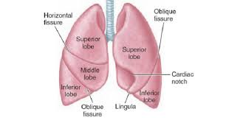

Slide 18
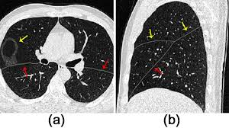
Fissures in CT

Slide 19
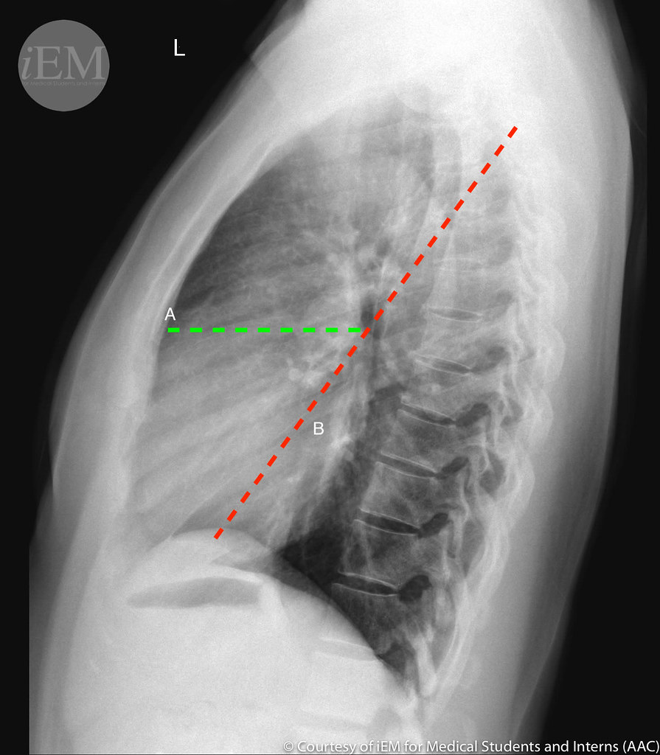
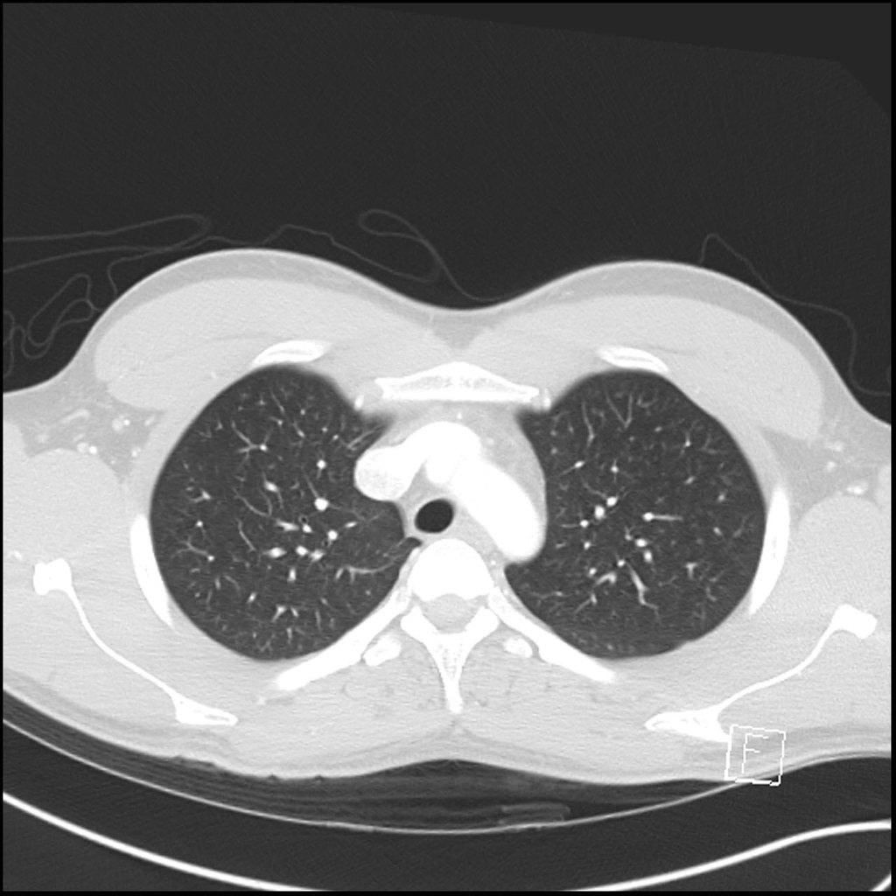
One air (trachea) …one lobe (upper lobe)

Slide 20
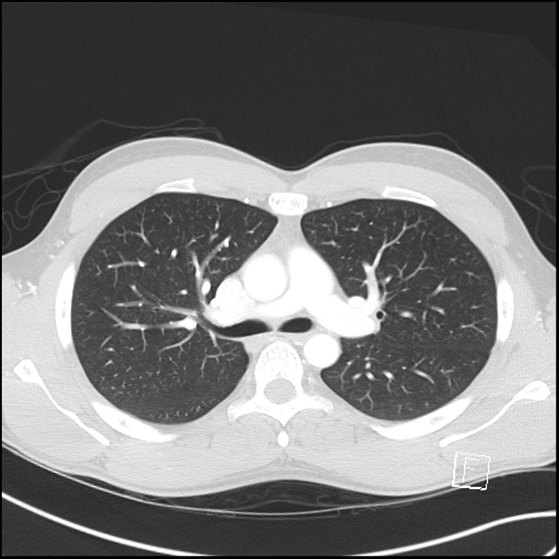
Two air (two bronchi)…two lobes (upper and lower)

Slide 21
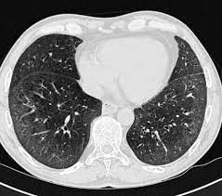
Heart level (middle lobe and lingula)

Slide 22
Right Lung: 3 Lobes (Upper, Middle, Lower)
Left Lung: 2 Lobes (Upper, Lower)
Key Fissures:
  Major (Oblique) Fissure: Separates upper/middle from lower lobes. Often incomplete.
  Minor (Horizontal) Fissure: Right side only. Separates RUL from RML.

Slide 23
Thank you

